Slide 1
Four Color Theorem
Khayyon Parker, Pietro Giacomin

Slide 2
Background History
Problem unsolved for 125 years, finally solved in 1970s.
The mathematical community thought it was solved falsely for an entire decade. (Academic Journal of Mathematics, Vol. 2 No. 3 (Sep. 1879) pp. 193-200.

Slide 3
Defining the theorem
*The four color theorem states that any separation of a plane into contiguous regions, also known as a "Map" can be colored using at most four colors where the regions in our graph G would only be considered adjacent if two regions share border (not just a point).

Slide 4
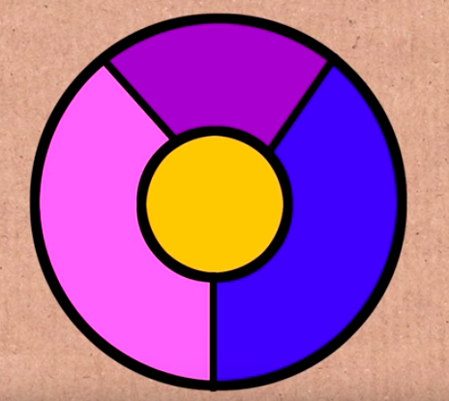
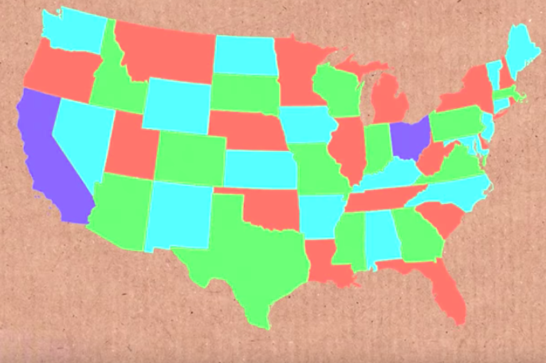
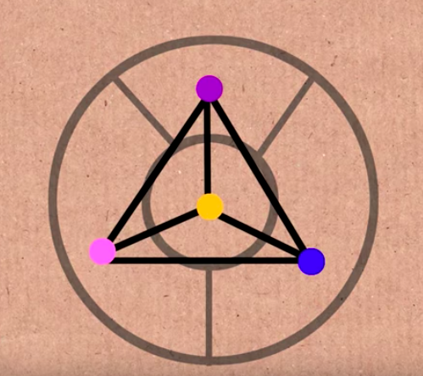
Map + Questions

Slide 5
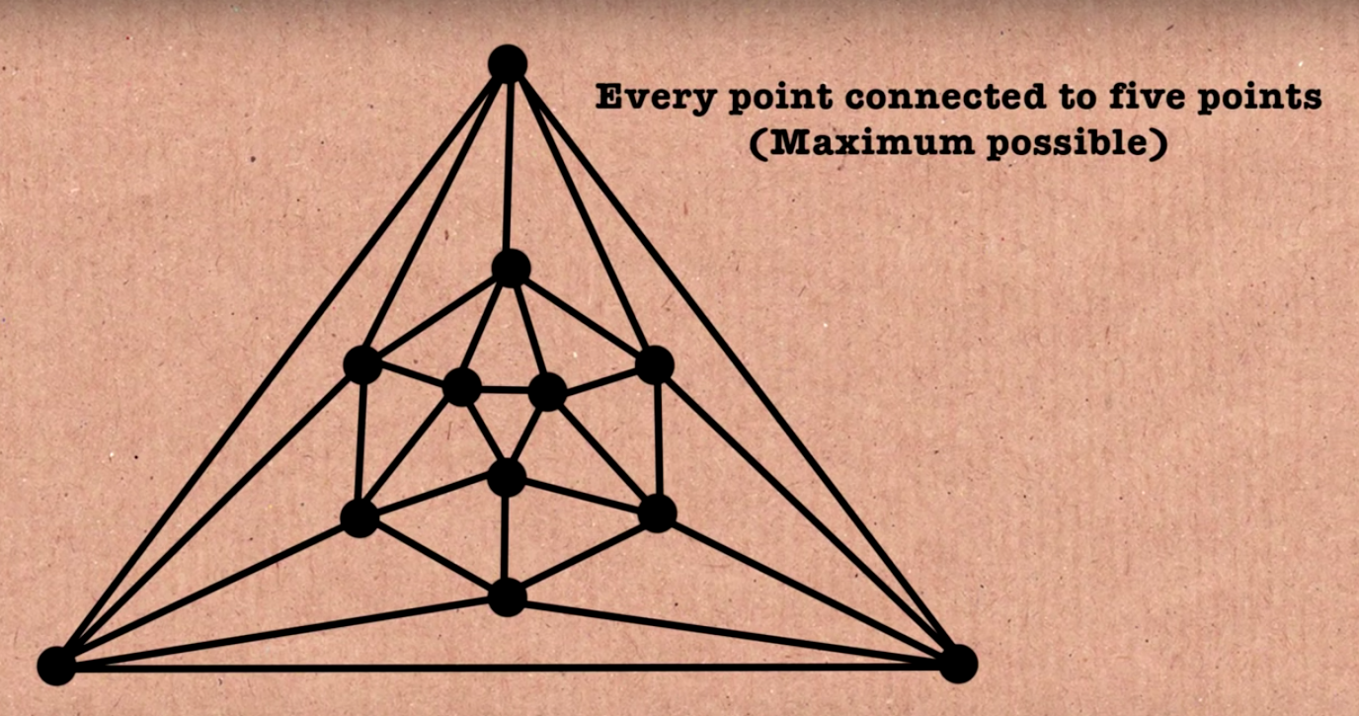
Given a country A … or a point N:

Slide 6
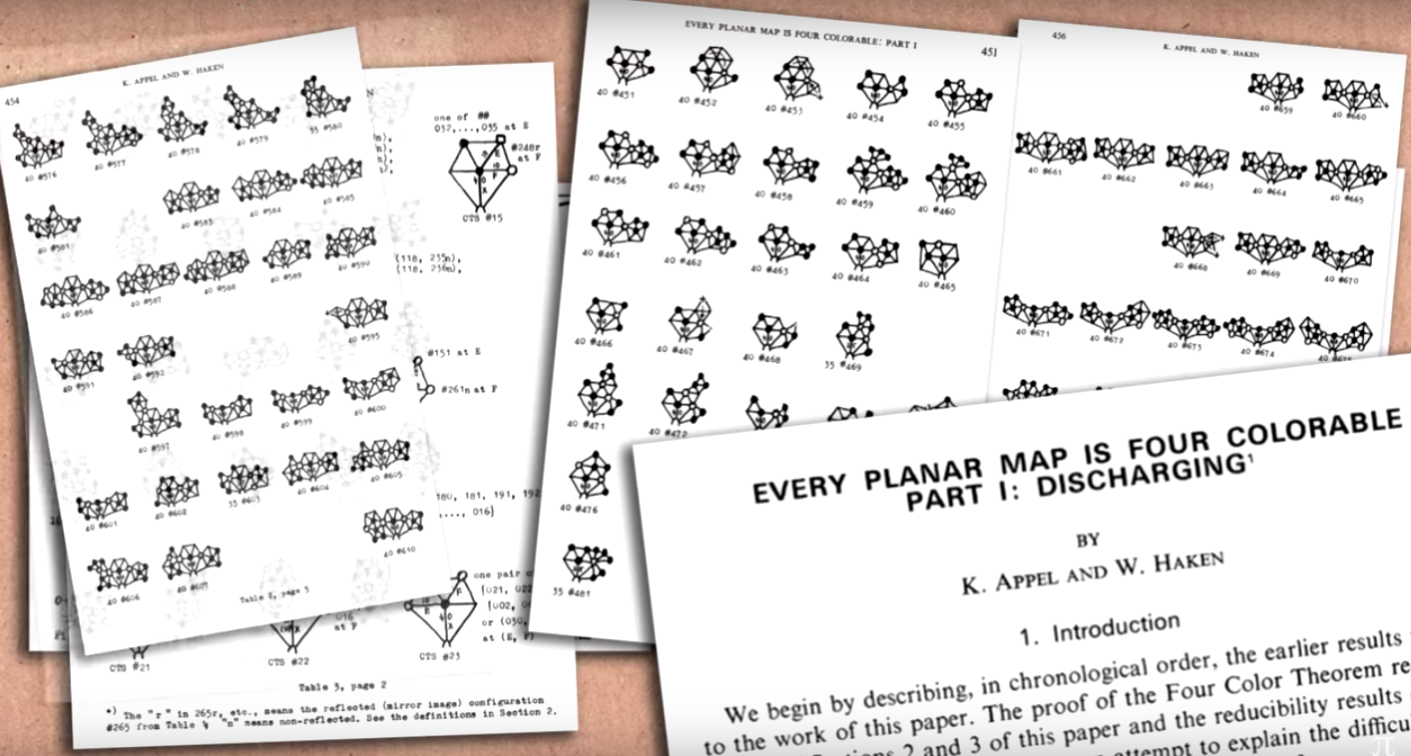
Notes:
1936 Configurations were on this list, that’s why this was the first computer assisted proof. Nowadays it has shortened to 1428 cases.

Slide 7
Proof Sketch: Every planar graph is 4 colorable
Proof: Let the planar graph with n vertices, n is at least 1, and denoted by Gn . There are 3 cases to discuss. Case 1: When 1 <= n <= 4, the result holds (it’s obvious, G1 – G4) Case 2: When n = 5, the maximal planar graph with 5 vertices is the full graph deleting an edge, i.e., the planar graph with 5 vertices and 9 edges, Case 3: There are a lot of Cases here
Show Flowchart of the 4-Color Theorem Show Algorithm being applied in Code

Slide 8
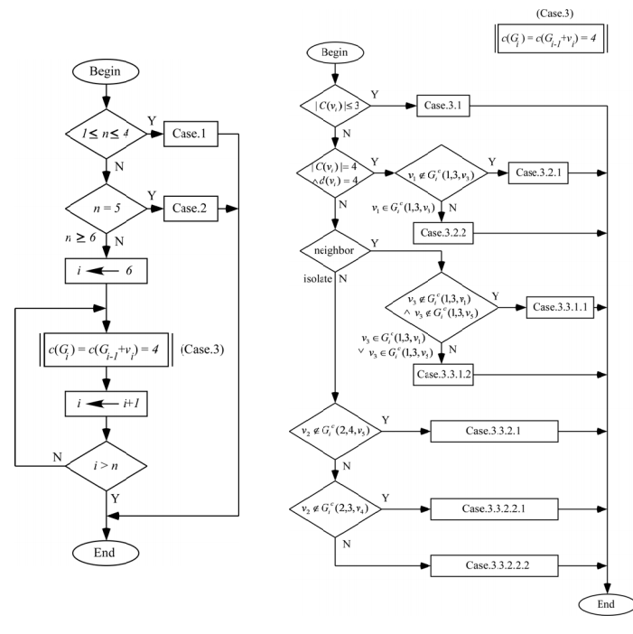
Code:

Slide 9
Thank you and References
https://arxiv.org/pdf/0905.3713.pdf
http://bit.ly/MSRINumberphile
Have a happy block break

